Slide 1
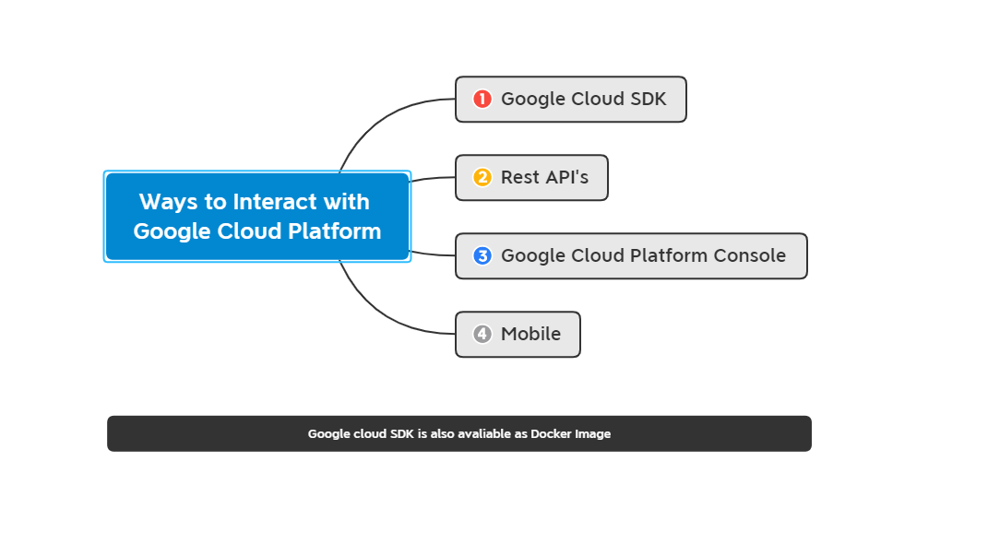

Slide 2
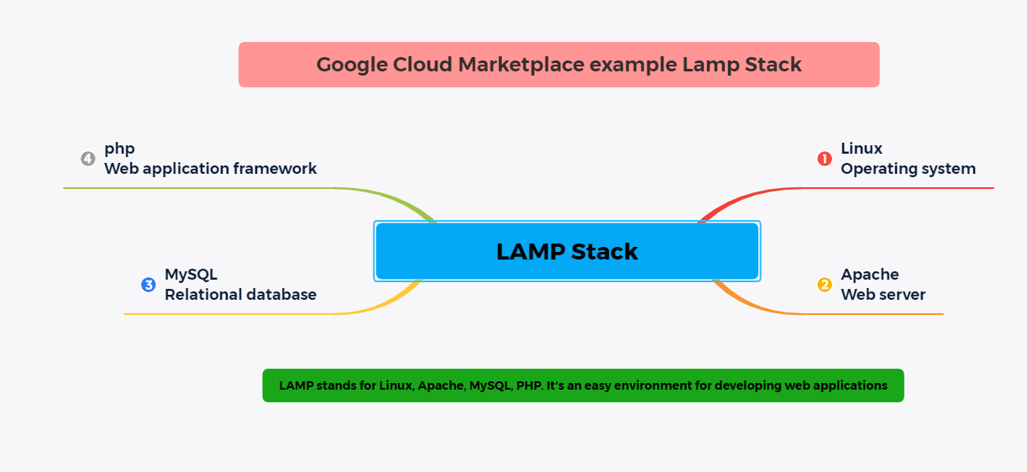

Slide 3
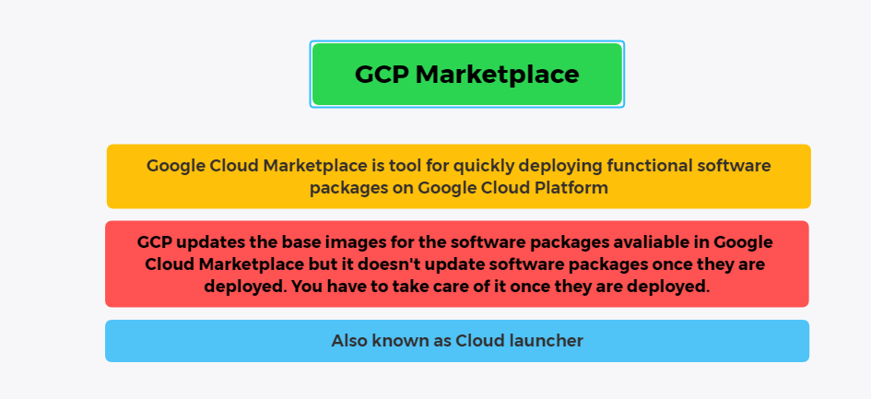

Slide 4
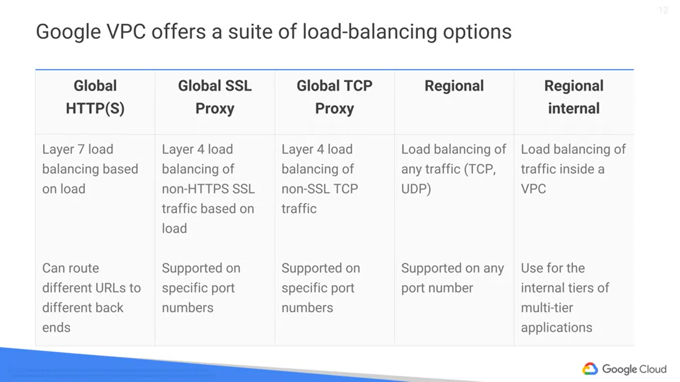

Slide 5
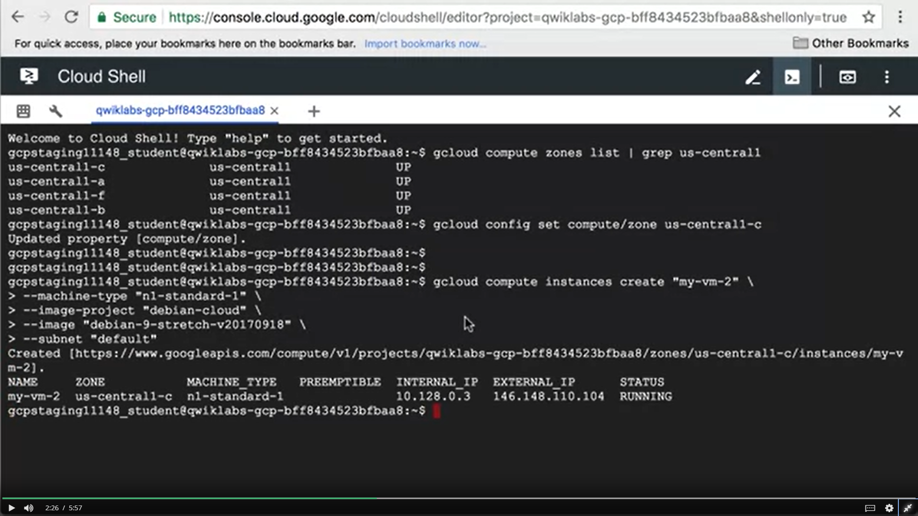

Slide 6
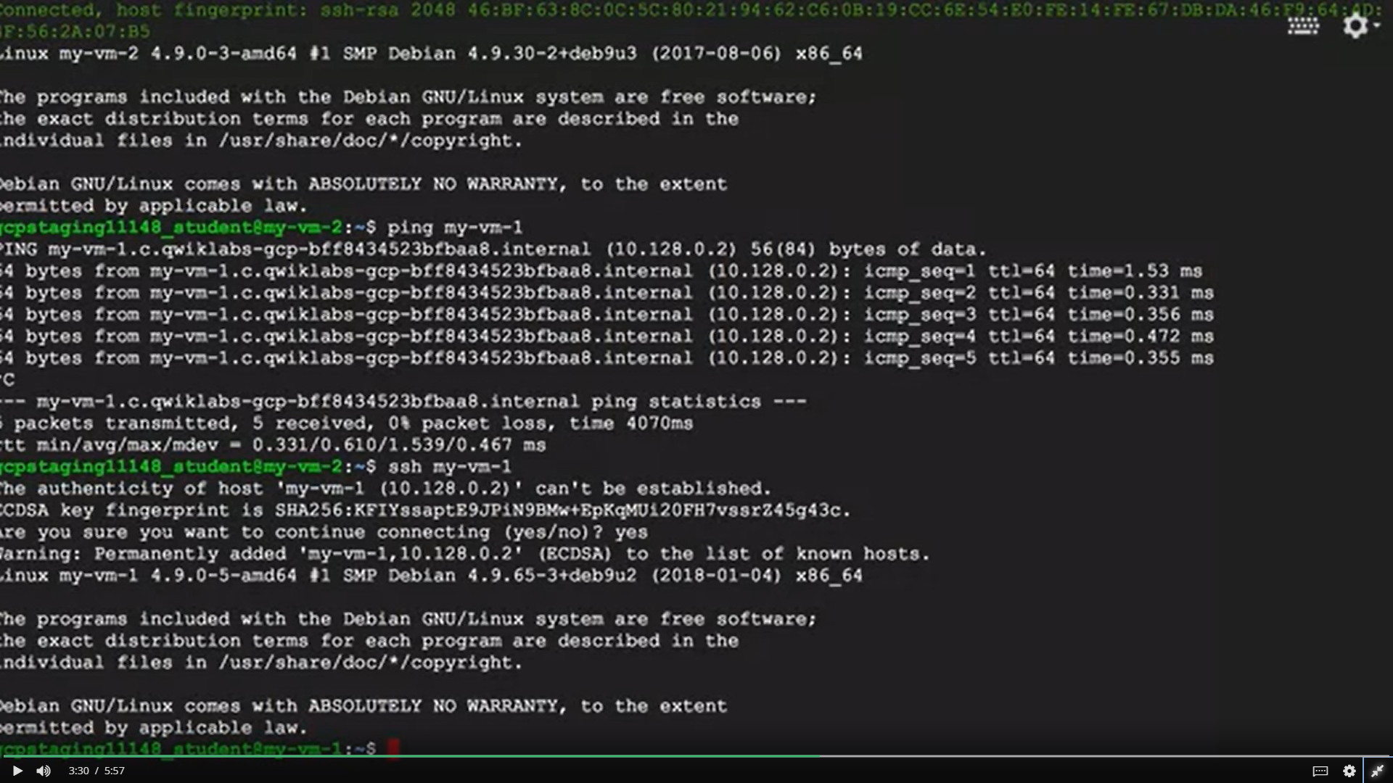

Slide 7
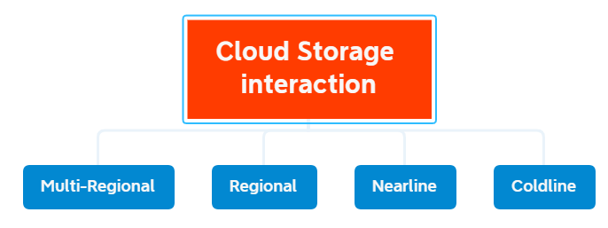
Normal Storage
Long lasting
Retrieval Cost
Storage Cost per GB

Slide 8
Google Cloud Bigtable
Cloud Bigtable is offered through the same open source API as HBase, which is the native database for the Apache Hadoop project.
Anyway, having the same API enables portability of applications between HBase and Bigtable.
Bigtable is actually the same database that powers many of Google's core services including search, analytics, maps and Gmail
From an application API perspective, data can be read from and written to Cloud Bigtable through a data service layer like Managed VMs, the HBase rest server or a Java server using the HBase client.
If streaming is not an option, data can also be read from and written to Cloud Bigtable through batch processes like Hadoop map reduce, Dataflow or Spark

Slide 9
Google Cloud SQL and Google Cloud Spanner
First, Cloud SQL provides several replica services like read, failover, and external replicas.
This means that if an outage occurs, Cloud SQL can replicate data between multiple zones with automatic failover.
Cloud SQL also helps you backup your data with either on-demand or scheduled backups.
It can also scale both vertically by changing the machine type, and horizontally via read replicas
You can authorize Compute Engine instances for access Cloud SQL instances and configure
the Cloud SQL instance to be in the same zone as your virtual machine.
Consider using Cloud Spanner if you have outgrown any relational database, or sharding your databases for throughput high performance, need transactional consistency, global data and strong consistency, or just want to consolidate your database.
Natural use cases include, financial applications, and inventory applications.

Slide 10
Google Cloud Datastore
Another highly scalable NoSQL database choice for your applications is Cloud Datastore.
One of its main use cases is to store structured data from App Engine apps.
You can also build solutions that span App Engine and Compute Engine with Cloud Datastore as the integration point.
Cloud Datastore automatically handles sharding and replication, providing you with a highly available and durable database
that scales automatically to handle load.
Unlike Cloud Bigtable, it also offers transactions that affect multiple database rows, and it lets you do SQL-like queries.
Cloud Datastore has a free daily quota that provides storage, reads, writes, deletes and small operations at no charge.

Slide 11
Comparing Storage Options
Cloud Datastore
Structured Data + 1 MB/entity + App Engine Applications
Cloud Bigtable
Don’t support SQL Queries + Single row
Cloud Storage
Immutable block + Normally greater than 10 MB (Images + Movies) + Max 5 TB / Object
Cloud SQL
Relational SQL Queries
EVOLVED
Cloud Spanner
Relational SQL Queries with Horizontal Scalibility

Slide 12
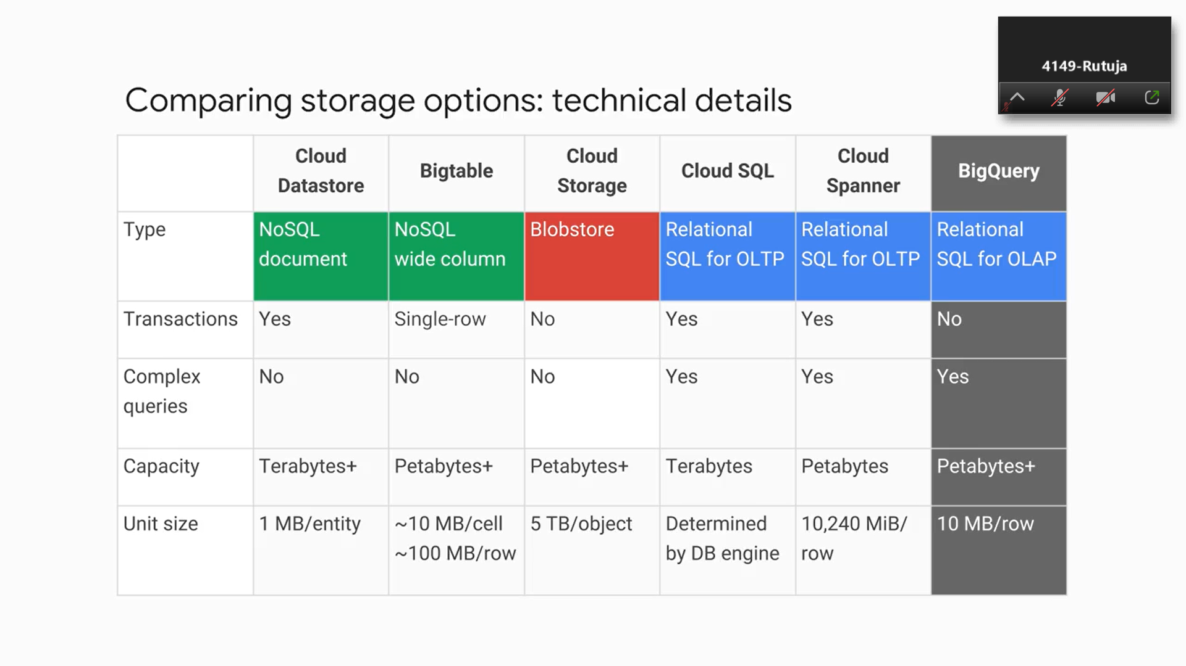
Free daily quota, separate from any free trials
Sensors
Media
Videos
Relational database - talk to MySQL
Strong transactional consistency
seamless scaling up

